Slide 1


Exploratory Analysis
Global Terrorism data

Slide 2
About the Dataset
This dataset is a collection of terrorism activities from 1970 to 2017
It has around 1,80,000 data points and data in 135 columns although we will reduce the data and work with only the most informative and categorical data. (i.e., drop data columns like summary, resolution)
You can download the dataset from here - https://bit.ly/2TK5Xn5

Slide 3
Straight facts obtained
Country with the most attacks : Iraq
City with the most attacks : Baghdad
Region with the most attacks : Middle East & North Africa
Year with the most attacks : 2014
Month with the most attacks : 5 (may)
Group with the most attacks : Taliban
Most Attack Types : Bombing/Explosion

Slide 4
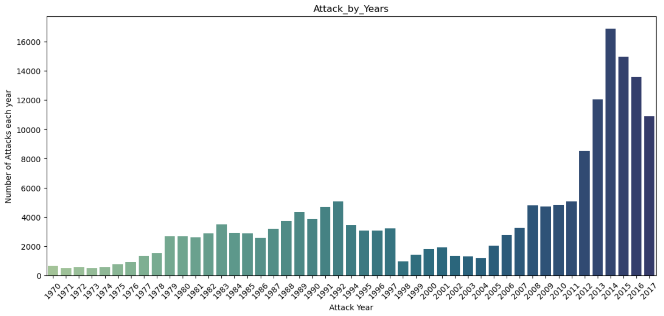
Number of Attacks every Year
We can see the terrorist activities have grown recently and has seen a sharp spike from 2012, with 2014 being the most attacked year.

Slide 5
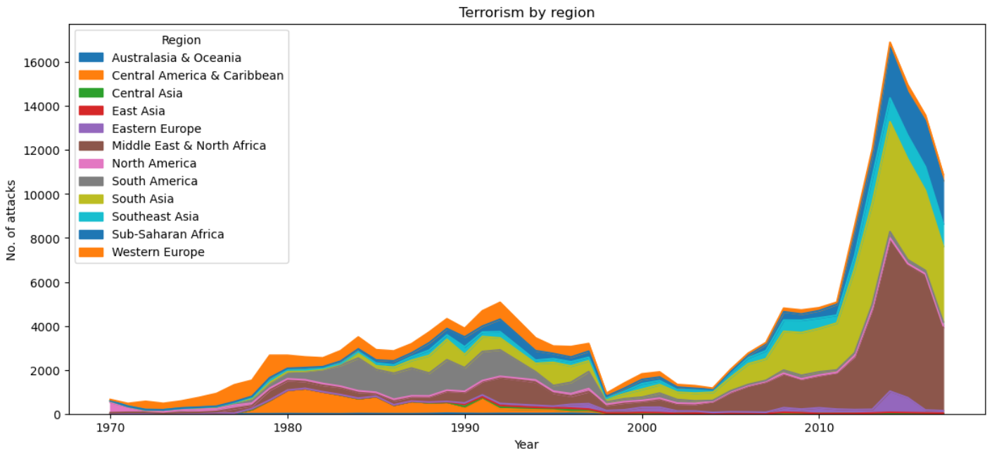
Attacks every Year by Region
We can see that Middle East & North African region has seen most attacks
We can see that in the 1980s and 1990s, Europe has seen most terrorist activities but almost negligible in the recent times.

Slide 6
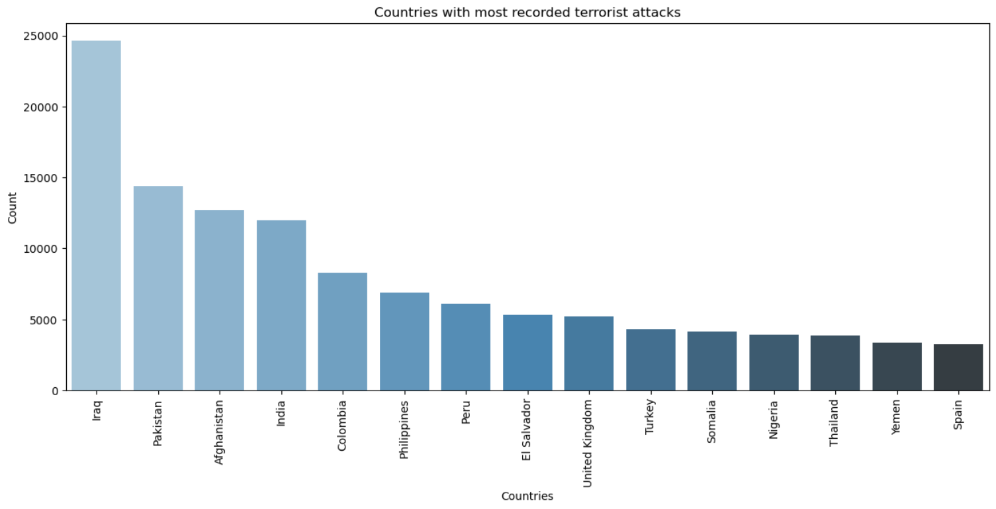
Most recorded terrorist attacks
Iraq has been the country with most terrorist attacks followed by South Asian nations.
Countries from Asia, Africa and South America can be seen with most attacks

Slide 7
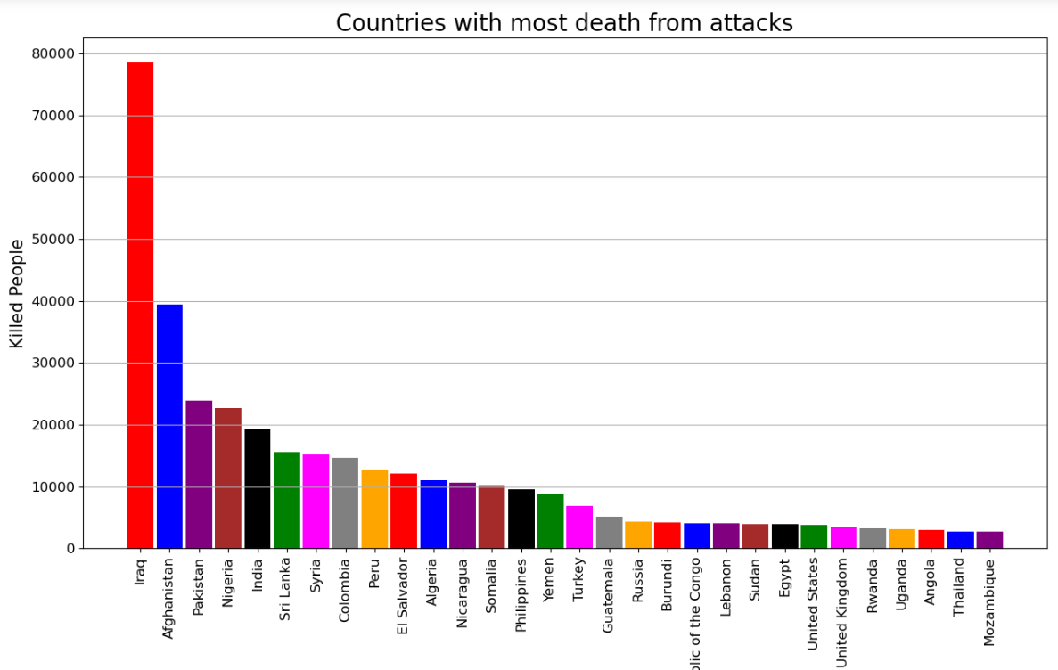
Countries with most casualties
Notably, Sri Lanka and Syria (rank 6, 7) has seen more casualties even though they weren’t on the list of countries with most terrorist attacks.

Slide 8
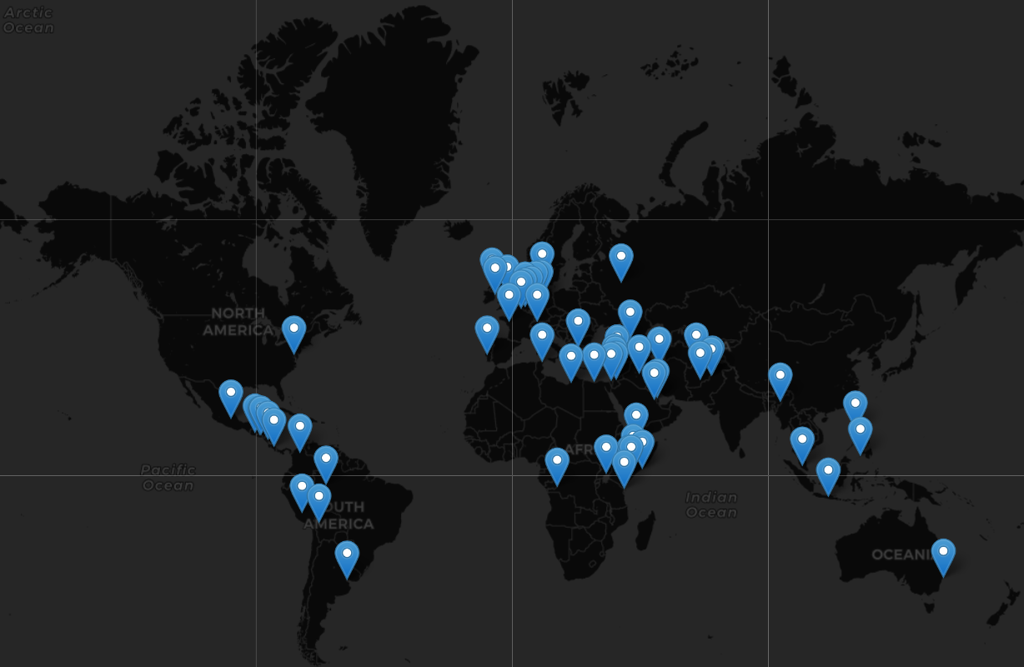
Countries attacked by top terrorist groups
Europe, Middle East and Central America has been the major targets for top 7 terrorist organizations across the globe.

Slide 9
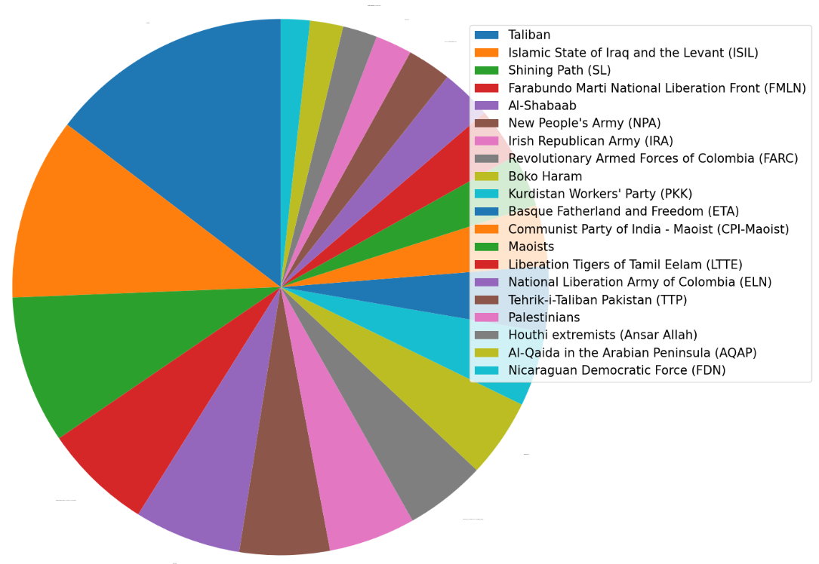
Terrorist groups involved in most attacks
Taliban, ISIL, Shining Path has been the top 3 notorious Terrorist groups involved in the most terrorist attacks.

Slide 10
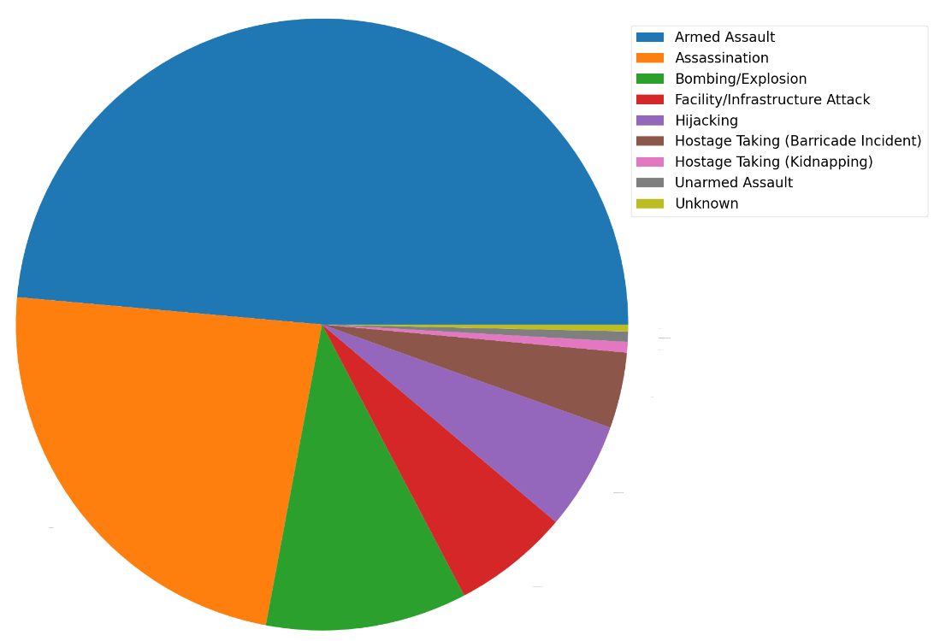
Weapon of Violence
Armed Assault, Assassinations, Bombing/Explosion, Targeting infrastructures and Hijacking were the means of destruction over 90% of the terrorists prefer.

Slide 11
Conclusion
From 2012, there has been a sharp increase in terrorist activities across the globe compared to the past 5 decades.
Middle East and North African region are facing the most terrorist attacks as on 2017
While Iraq and South Asian countries like Pakistan, Afghanistan and India has been the hotspot for the most terrorist attacks in the given period, Sri Lanka and Syria has also seen a lot of casualties.
Back in the days, Europe and Central America were notorious but has now took good control of their terrorism environment.
Taliban who recently took control of Afghanistan has been the most notorious Terrorist group followed by ISIS.

